Slide 1
I Believe Essay
By Madison Sanchez

Slide 3
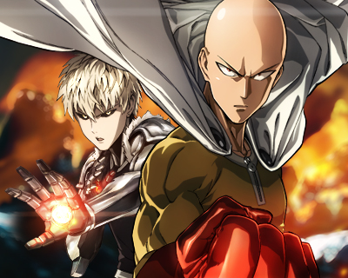

Slide 7
